Slide 1
Real Estate Investment Analysis
M Jyothi

Slide 2
Real Estate Investment Analysis
Business Objective
Identify good properties to invest in
Understand factors affecting property prices
Business Problem
People invest without proper analysis, we are analyzing which property is a good investment:
Undervalued price (cheaper than similar properties nearby)
High demand drivers (transport, schools, hospitals)
Future appreciation potential (developing locality, newer property)
Rental attractiveness (amenities, furnishing, accessibility)

Slide 3
We are analyzing data of properties across India which contains 250000 rows and 22 columns
Core variables:
Location: State, City, Locality
Property: Property_Type, BHK, Size_in_SqFt
Price: Price_in_Rs, Price_per_SqFt
Infrastructure :
Nearby_Schools, Nearby_Hospitals, Public_Transport_Accessibility, Parking_Space, Security
Property features:
Year_Built, Age_of_Property, Furnished_Status, Floor_No, Total_Floors
Amenities: Clubhouse, Gym, Pool, Garden, Playground
Data Preprocessing
Handle missing values and duplicates: The data is free from missing and duplicate values
For easy calculation and understanding changed the below columns
Price_in_Rs = Price_in_lakhs * 100000
Modifying existing Price_per_SqFt column with new calculation as the value is given in lakhs and rounded off to near value
Price_per_SqFt = Price_in_Rs/ Size_in_SqFt
Deleting columns
As Total_floors cannot be less than Floor_no we can remove those rows, but they contribute to 116304 rows, so instead replaced those property_type with Independent house and villa with 1 which satisfy the above condition. So we are reducing those to 38,639 rows are deleted.

Slide 4

Adding Columns
Based on the Amenities column added columns (Garden, Pool, clubhouse, gym, playground and amenities_count) by creating amenities dummies columns
Age_of_Property = current_year - Year_Built
Local_avg_price : find median of Price_per_SqFt by grouping city and locality
Undervalued: Price_per_SqFt < local_avg_price
Age_score : Age_of_Property <= 5 then 3, Age_of_Property <= 15 then 2 else 1
Livability_score : amenities_count + Parking_Space (yes =1, no =0) + Security (yes =1, no =0)
Investment_score : undervalued*3 + location_score*2 + age_score*2 + livability_score
Appreciation_rate: sort values by 'City', 'Locality', 'Year_Built‘ and then find pct_change of Price_per_SqFt groupby 'City', 'Locality‘
Price_bucket: "<20L", "20-50L", "50L-1Cr", "1-2Cr", "2-5Cr“
Size_bucket: "<1K", "1K-2K", "2K-3K", "3K-4K", "4K-5K"
Good Properties:
Investment score > 75% of investment score
Good Investment :
Appreciation rate > threshold

Slide 5
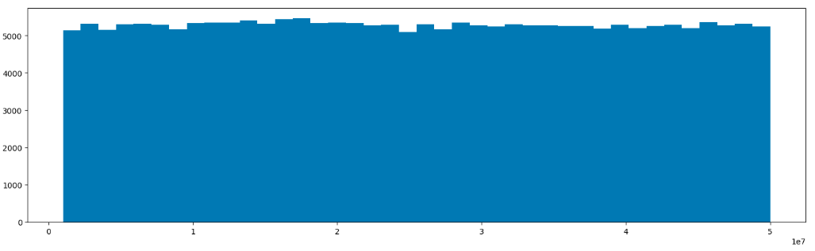
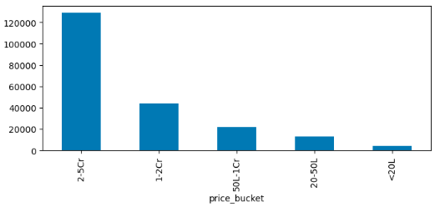

What is the distribution of property prices?
We can see the distribution as uniform distribution but with 48,313 unique values out of ~2.1M rows, data is not synthetic uniform data. Instead, it’s likely:
Highly repeated + fairly evenly spread across the range
Majority in ₹2Cr – ₹5Cr range
Drop after ₹1Cr - ₹2Cr range
Very small % in <₹20L

Slide 6
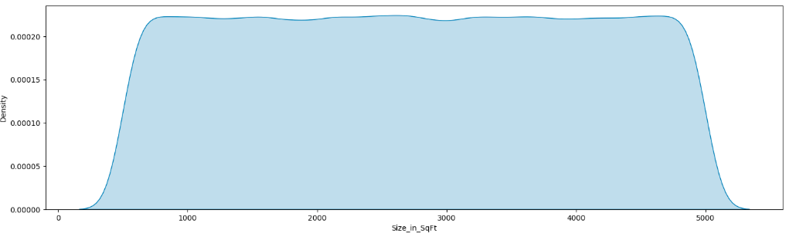
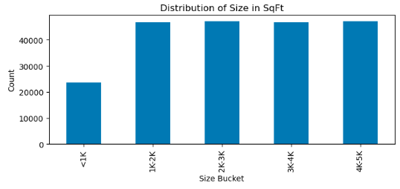

What is the distribution of property sizes?
The size distribution is essentially uniform between ~500 and 5000 sqft, with each bucket having nearly equal counts—no dominant size range. The smooth KDE and flat bar chart confirm the data is evenly (likely synthetically) distributed, not reflecting real-world housing patterns
The counts are nearly uniform across 1K–5K sqft buckets, with only the <1K range lower due to the truncated starting bound at 500 sqft

Slide 7
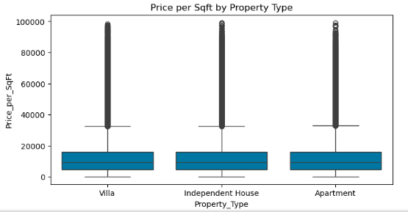

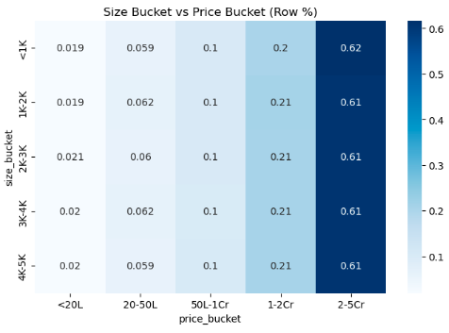
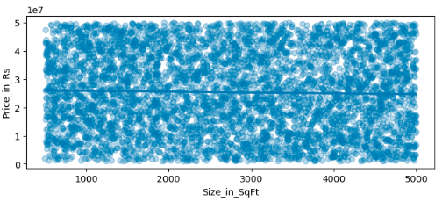
How does price per sq ft vary by property type?
We can see Price_per_sqft is not affected by the property_type as the mean is almost ~13000 rupees per_sqft with slightly lower price ~75 rs for Villa
Price distribution is nearly identical across all size buckets, with ~60% of properties falling in the 2–5Cr range regardless of size.
This shows little to no relationship between size and total price, meaning other factors (or synthetic structure) are dominating pricing.
Is there a relationship between property size and price?

Slide 8
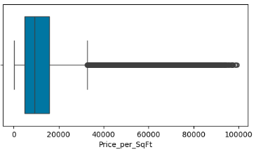
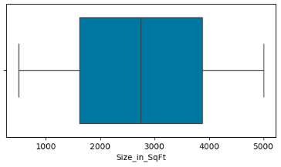
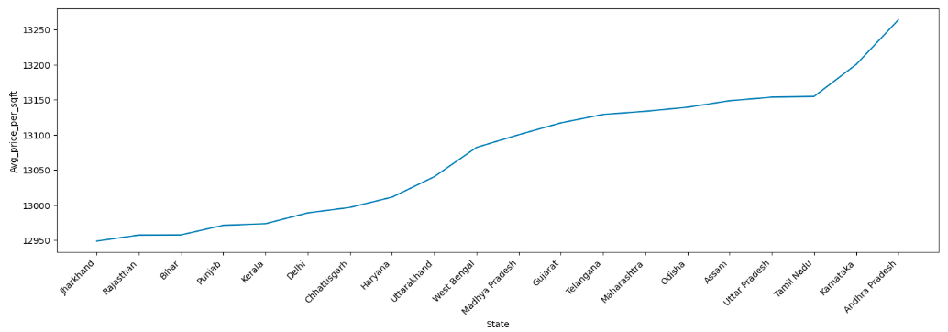
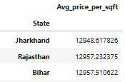

Are there any outliers in price per sq ft or property size?
There are no outliers in Size_per_SqFt but outliers in Price_per_SqFt after ~33000
What is the average price per sq ft by state?
There is no much difference between states average_price_per_sqft as there vary ~300 b/w the top 1 and bottom 1 state

Slide 9
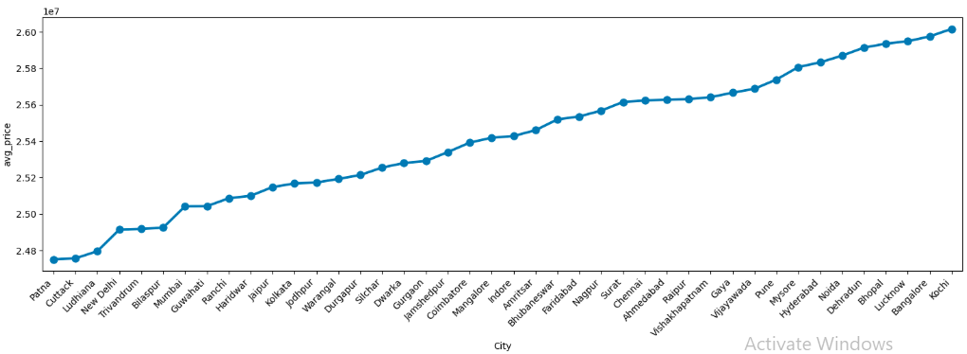
What is the average property price by city?
The Average Property price by city ranges between 2.48Cr Patna to 2.60 Cr Kochi (median) . With ~12lakh rupees difference between the highest and lowest price cities
What is the median age of properties by locality?
Median age of Localities vary between 17-22 years

Slide 10
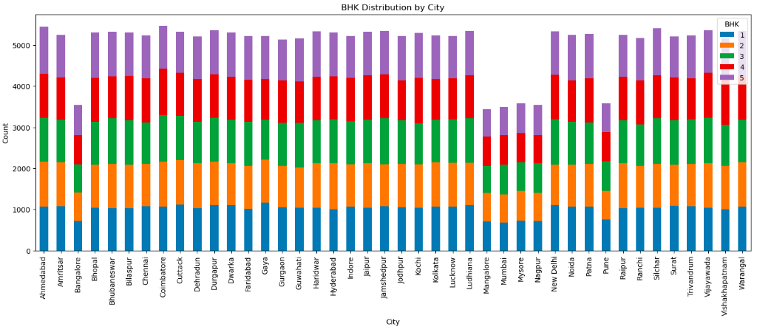
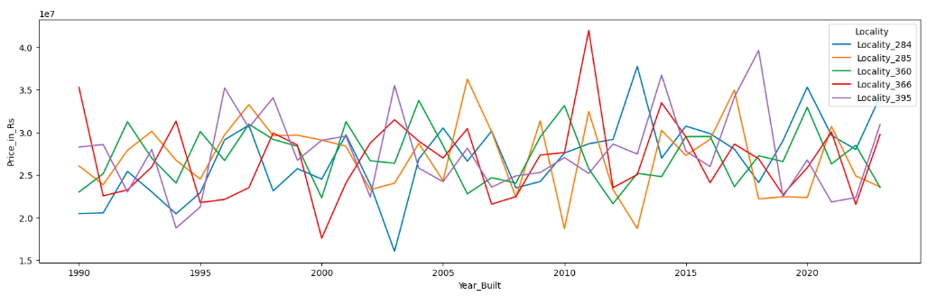
How is BHK distributed across cities?
No. of properties
Coimbatore 5476 Ahmedabad 5449 Silchar 5405 Vijayawada 5360 Durgapur 5355 Warangal 5350
Mysore 3580
Pune 3579
Bangalore 3547
Nagpur 3538
Mumbai 3496 Mangalore 3440
We can see BHK are distributed equally among cities. Cannot find much difference in distribution
'Locality_395', 'Locality_366', 'Locality_285', 'Locality_284', 'Locality_360‘
Locality_284 touched the lower peak of Rs1.60 Cr in 2003
Locality_366 touched the highest peak of Rs4.19 Cr in 2011
What are the price trends for the top 5 most expensive localities?

Slide 11
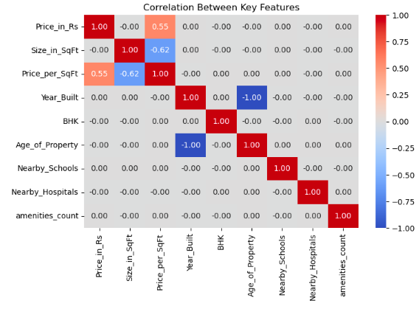
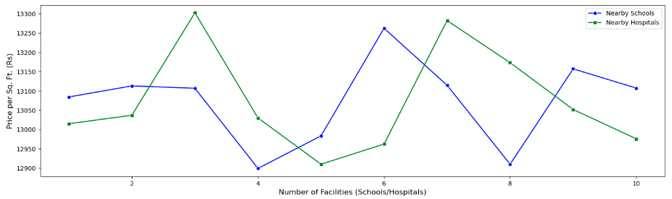
How are numeric features correlated with each other?
Price is moderately driven by price per square foot The correlation between Price_in_Rs and Price_per_SqFt (~0.55) suggests that higher per-unit pricing significantly influences overall property price.
Larger homes tend to have lower price per square foot The negative correlation between Size_in_SqFt and Price_per_SqFt (~ -0.62) indicates a common trend: bigger properties often get a lower per-unit rate.
Age and year built are perfectly inversely related The strong negative correlation (~ -1.00) between Year_Built and Age_of_Property is expected—newer properties naturally have lower age, confirming data consistency.
How do nearby schools and nearby schools relate to price per sq ft?
More nearby schools generally correlate with slightly higher property prices.
Hospital proximity shows sharper price spikes at certain points.
Schools have a steadier impact, while hospitals create more variable pricing trends.

Slide 12
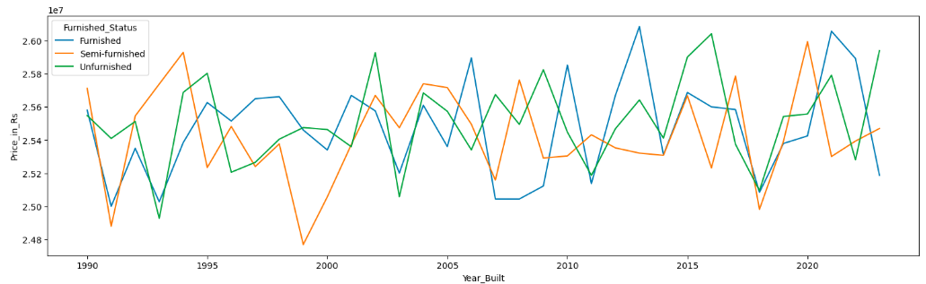
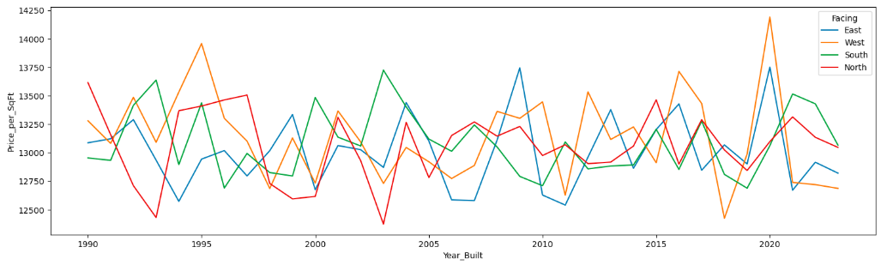
How does price vary by furnished status?
Prices are fairly similar across furnishing types.
Slight peaks for furnished homes in recent years. Furnished properties occasionally show higher price spikes, especially in newer constructions.
No clear upward or downward trend over time
How does price per sq ft vary by property facing direction?
West-facing homes often reach the highest prices
All facing types fluctuate similarly over time
Price differences between directions are relatively small While there are occasional spikes, overall the gap between facing types is not very large, indicating direction has limited impact on price per sq ft.

Slide 13
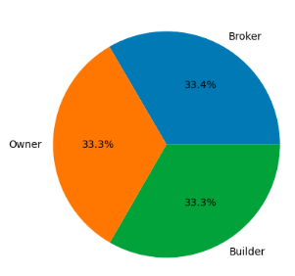


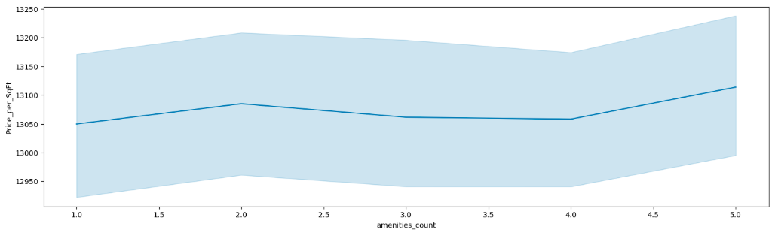
How many properties belong to each owner type?
How many properties are available under each availability status?
50% are Under_construction and 50% Ready_to_move
Does parking space affect property price?
Difference of ~55k rupees is there between those who have parking space and those who have not
Mild positive relationship: As amenities_count increases, price_per_sqft trends slightly upward. Small dip in the middle: There’s a noticeable flattening or slight decline around 3–4 amenities, indicating the relationship isn’t strictly linear and may be influenced by other factors. Wide variability: The shaded band (likely variability or confidence interval) is fairly broad across all points, meaning prices vary significantly even within the same amenities count.
How do amenities affect price per sq ft?

Slide 14
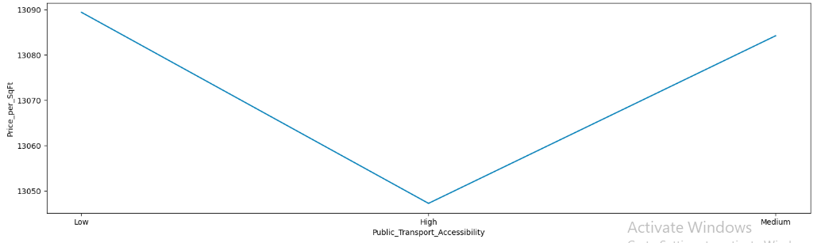

How does public transport accessibility relate to price per sq ft or investment potential?
Price_per_sqft is low for High Transport Accessibility compared to low and medium ~Rs.40 per sq.ft

Slide 15
Investment Insights (1/2)
Larger properties tend to have lower price per sq.ft, shown by the strong negative correlation between size and price_per_sqft (~ -0.62).
Ready-to-move properties cost about ₹70,000 more on average than under-construction properties.
Properties with more amenities generally have higher prices, with around ₹48,000 difference between 1 and 5 amenities.
Owner-listed properties are cheaper by roughly ₹62,000 compared to broker or builder-listed properties.
Parking availability increases property value, with about ₹55,000 higher prices for properties having parking space
Security : Properties with security facilities have an average property value higher by approximately ₹1.46 lakh compared to properties without security.
Cities: Average property prices across cities range from approximately ₹2.48 Cr in Patna to ₹2.60 Cr in Kochi, showing a relatively narrow variation of about ₹12 lakh overall.
Southern metro cities like Kochi, Bangalore, Hyderabad, and Chennai appear among the highest-priced markets, indicating stronger demand and urban growth.
Patna, Cuttack, and Ludhiana show the lowest average prices, making them comparatively more affordable investment locations.
West-facing homes often reach the highest prices No clear upward or downward trend over time
BHK is not a strong value differentiator Since prices (₹2.539–₹2.551 Cr) and price per sq.ft (~₹13,000) are almost the same across 1–5 BHK, investing based only on BHK won’t give much advantage.
1–2 BHK units can be better for rental yield
3 BHK may offer better resale liquidity
No “premium pricing” for larger BHKs

Slide 16
Investment Insights (2/2)
States: Price variation across states is small (~₹4 lakh range)
Price per sq.ft is tightly clustered (~₹12,950–₹13,260) Even the highest (Andhra Pradesh ~₹13,263) and lowest (Jharkhand ~₹12,948) differ by only ~₹300–₹350, indicating weak state-level pricing impact.
Investment insight: location within state matters more than state itself Since differences are minimal, returns are likely driven more by city, micro-location, amenities, and demand, not just the state.
Furnished_Status: Unfurnished properties have the highest average price (~₹2.551 Cr)
Furnished properties are slightly cheaper (~₹2.547 Cr)
Price variation is very small (~₹8–9 lakh range) This shows furnishing status has low impact on investment returns
Rental income → Semi-furnished (higher per sq.ft efficiency) Long-term resale → Unfurnished (slightly higher total value & flexibility)

